Slide 1

Design for Testability
By
Dr.Rohit Lorenzo
Assistant Professor Sr. Grade -1
School of Electronics Engineering (SENSE)

Slide 2
Introduction
The task of determining whether fabricated chips are fully functional is highly complex and can be very time-consuming.
As the number of transistors integrated into a single chip increases, the task of chip testing to ensure correct functionality becomes increasingly more difficult.
However, in a production environment, many chips must be tested within a short time for timely delivery to customers. To overcome such difficult issues, design for testability has become ever more critical.

Slide 3
Fault types and models
Chip testing, in the conventional sense, is usually multi-purpose and attempts to detect faults in fabrication, design, and failures due to stressful operating condition.
The main difficulty in testing is caused by the fact that only input and output pins of DUT are accessible.
As the operating clock frequency of the chip's increases beyond several tens of megahertz, the at-speed test has also become a difficult problem.
The tester to DUT and in detecting response signals from DUT due to impedance mismatch.
In addition to the tester problem, the generation of correct test vectors to detect all modeled faults and design errors in complex chips, either manually or through an automatic test patter generator (ATPG).
we will limit our discussion to faults caused by physical defects.
Examples of physical defects include:
* Defects in silicon substrate
* Photolithographic defects
* Mask contamination and scratches
* Process variations and abnormalities
* Oxide defects

Slide 4
Continued…..
The physical defects can cause electrical faults and logical faults. The electrical faults include
Shorts (bridging faults)
* Opens
* Transistor stuck-on, stuck-open
* Resistive shorts and opens
* Excessive change in threshold voltage
* Excessive steady-state currents
The electrical faults in turn can be translated into logical faults. The logical faults include:
* Logical stuck-at-0 or stuck-at-1
* Slower transition (delay fault)
* AND-bridging, OR-bridging

Slide 5
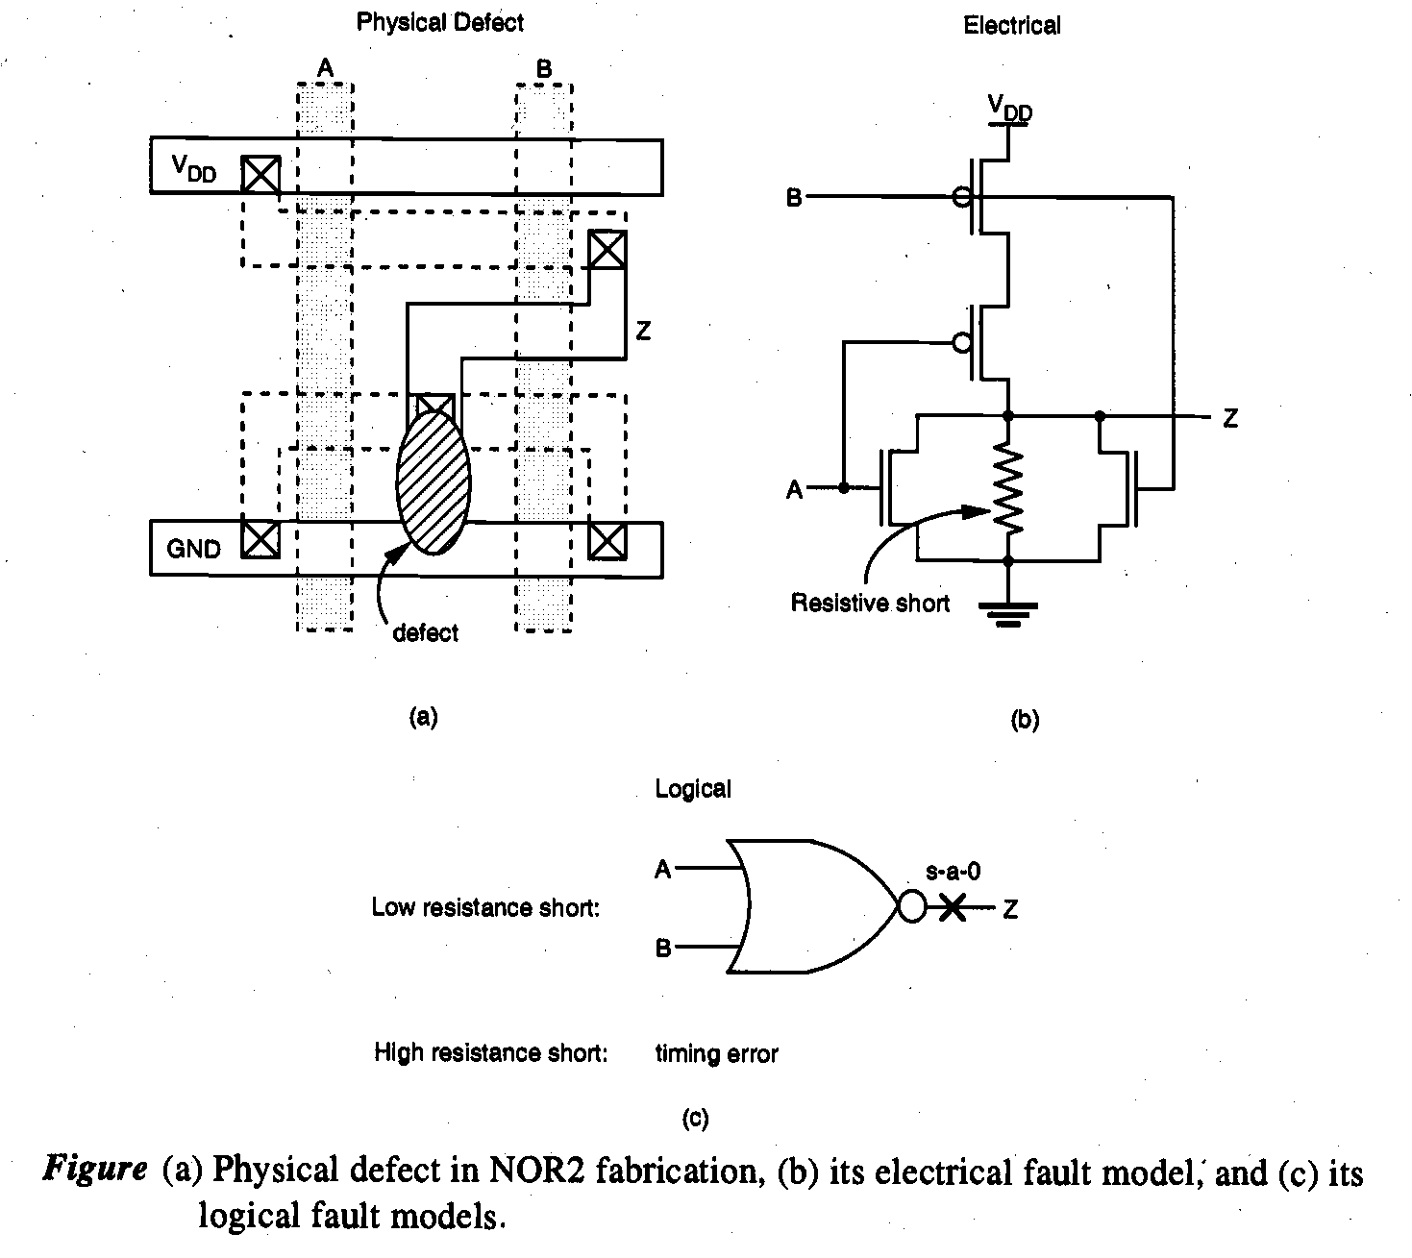
Continue…..
The relationships between physical defects, electrical faults, and logical faults can be explained using a simple NOR2 gate as shown in Fig.

Slide 6
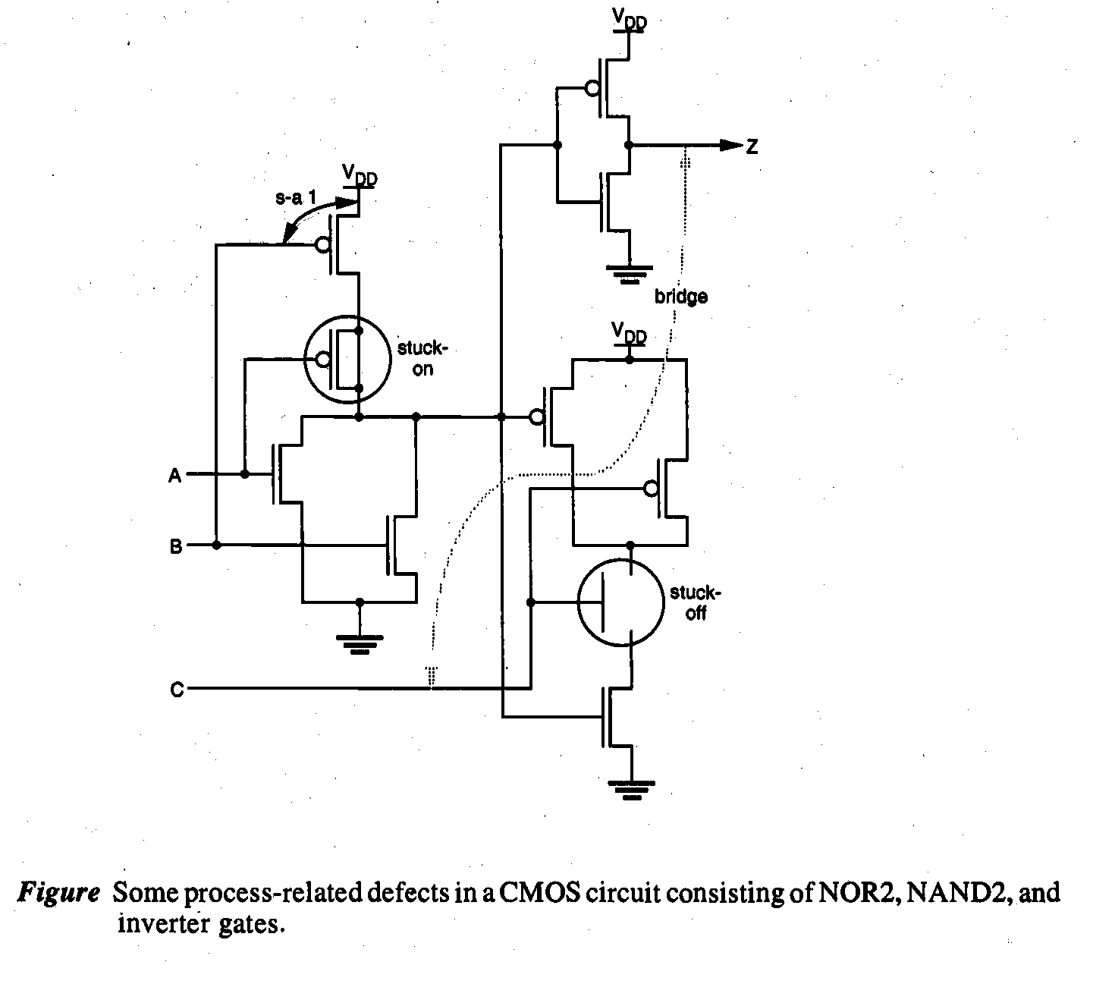
Continue…..
Figure shows other types of faults in a CMOS circuit consisting of NOR2,NAND2, and inverter gates. In this circuit, the input line B can be stuck-at- 1 (s-a- 1), since some part of the input line is shorted to the power rail. The pMOS transistor of the first stage NOR2 gate is stuck-on due to a process problem that causes a short between its source and drain terminals. The top nMOS transistor in the NAND2 gate, on the other hand, is stuck-open due to either an incomplete contact (open) of the source or drain node.

Slide 7
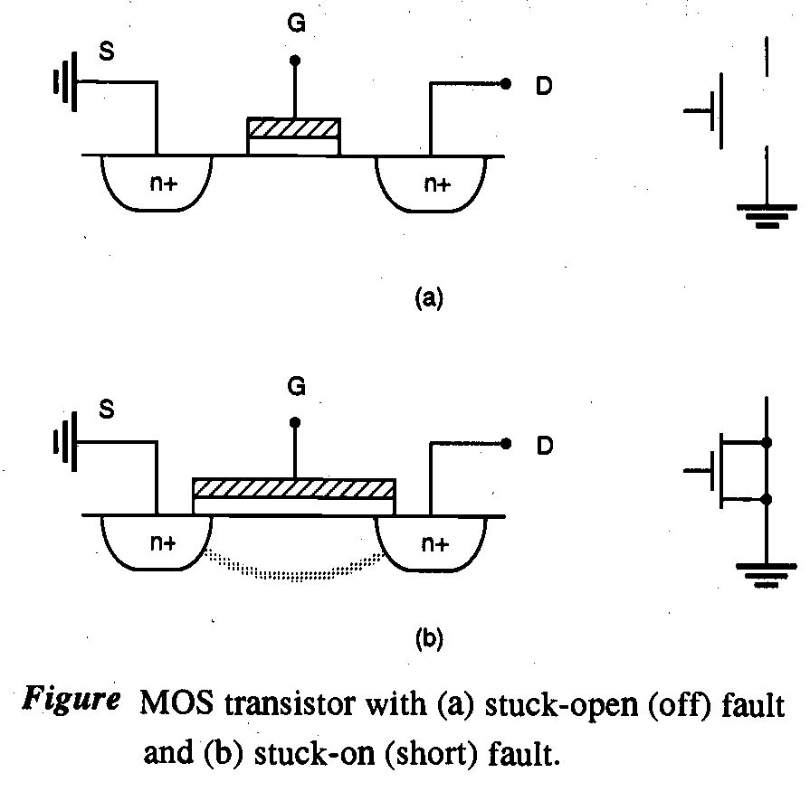
Continue….
The stuck-on and stuck-open faults are elaborated on in Fig.

Slide 8
Continue….
The delay fault which causes timing failures at target speed can be due to several factors.
improper estimation of on-chip interconnect delays
excessive variations in the fabrication process
opens in metal lines connecting parallel transistors
aging effects such as hot-carrier induced delay increase.
The fault models mentioned above are used in fault simulation aimed at
* Test generation,
* Construction of fault dictionaries, or
* Circuit analysis in the presence of faults.

Slide 9
Controllability and Observability
Controllability
The controllability of a circuit is a measure of the ease (or difficulty) with which the controller (test engineer) can establish a specific signal value at each node by setting values at the circuit input terminals.
Observability
The observability is a measure of the ease (or difficulty) with which one can determine the signal value at any logic node in the circuit by controlling its primary input and observing the primary output. Here the term primary refers to the I/O boundary of the circuit under test.
There are deterministic procedures for test generation for combinational circuits, such as the D-algorithm. The D-algorithm requires a large amount of computer time.
To overcome such shortcomings, many improved algorithms such as Path-Oriented Decision Making (PODEM) and FAN-out-oriented test generation (FAN) have been introduced.

Slide 10
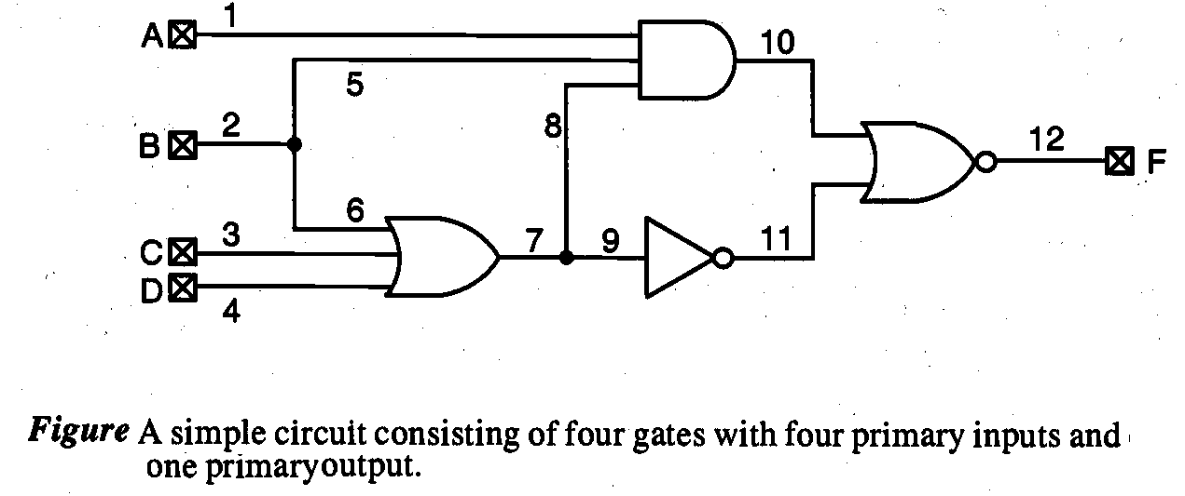
Continue…
Let us now consider the simple circuit. To detect any defect on line 8, the primary inputs A and B must be set to logic 1.However, such a setting forces line 7 to logic 1.
Thus, any stuck-at- (s-a- 1) fault on line 7 cannot be tested at the primary output, although in the absence of such a fault, the logic value on line 7 can be fully controllable through primary inputs B, C, and D. This circuit is not fully testable.
The main cause of this difficulty in this circuit is the fact that input B fans out to lines 5 and 6, and then after the OR3 gate, both line signals are combined in the AND3 gate. Such a fanout is called reconvergent fanout.

Slide 11
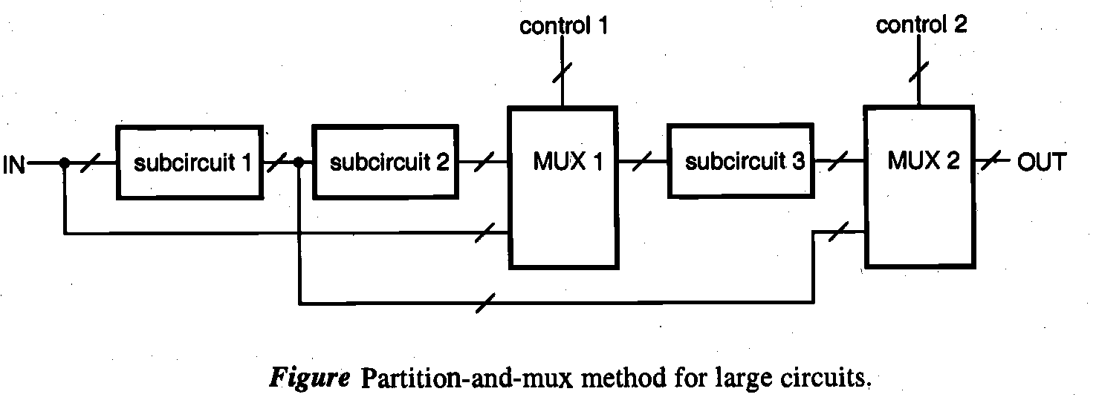
Ad Hoc Testable Design Techniques
One way to increase the testability is to make nodes more accessible at some cost by physically inserting more access circuits to the original design.
Partition-and-Mux Technique
The sequence of many serial gates, functional blocks, or large circuits are difficult to test, such circuits can be partitioned and multiplexors (muxes) can be inserted such that some of the primary inputs can be fed to partitioned parts through multiplexers with accessible control signals.Circuit partitioning and addition of multiplexers may increase the chip area and circuit delay.

Slide 12
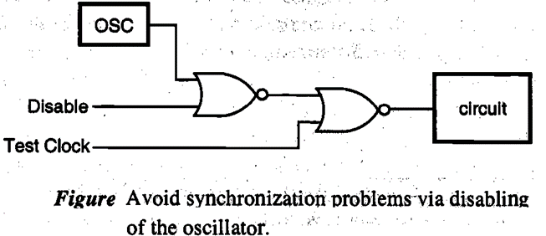
Continue…..
Initialize Sequential Circuit
When the sequential circuit is powered up, its initial state can be a random, unknown state. In this case, it is not possible to start the test sequence correctly.
The state of a sequential circuit can be brought to a known state through initialization. In many designs, the
initialization can be easily done by connecting asynchronous preset or clear-input signals
Disable Internal Oscillators and Clocks
To avoid synchronization problems during testing, internal oscillators and clocks should be disabled.For example, rather than connecting the circuit directly to the on-chip oscillator, the clock signal can be ORed with a disabling signal followed by an insertion of a testing signal as shown in Fig

Slide 13
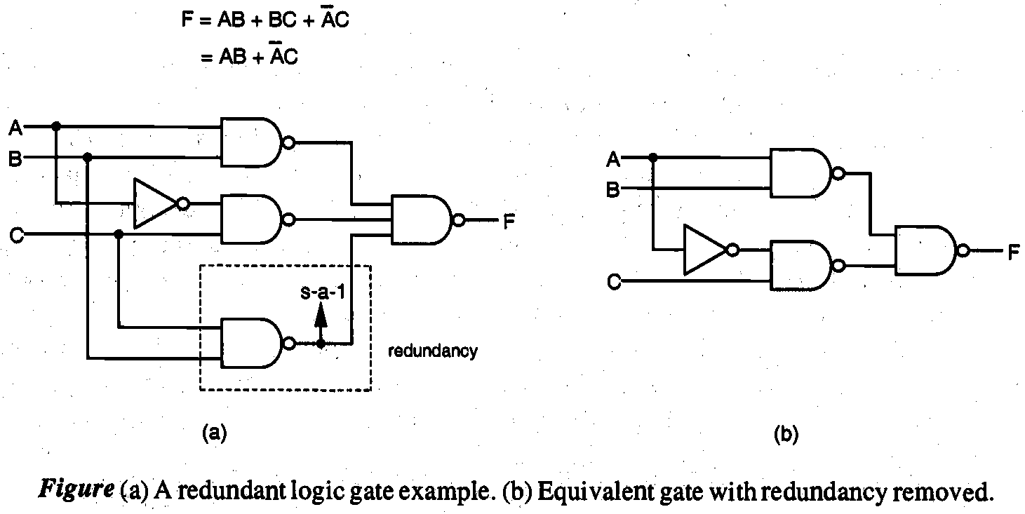
Avoid Asynchronous Logic and Redundant Logic
The design and test of an asynchronous logic circuit are more difficult than for a synchronous logic circuit, and its state transition times are difficult to predict.
The operation of an asynchronous logic circuit is sensitive to input test patterns, often causing race problems and hazards of having momentary signal values opposite to the expected values.
Figure shows that the bottom NAND2 gate is redundant and the stuck-at- fault on its output line cannot be detected. If a fault is undetectable, the associated line or gate can be removed without changing the logic function.

Slide 14
Scan based Technique
The scan design technique is a structured approach to design sequential circuits for testability.The storage cells in registers are used as observation points, control points, or both. By using the scan design techniques, the testing of a sequential circuit is reduced to the problem of testing a combinational circuit.
In the scan-based design, the storage elements are connected to form a long serial shift register, the so-called scan path, by using multiplexors and a mode (test/ normal) control signal, as shown in Fig.In the test mode, the scan-in signal is clocked into the scan path, and the output ofthe last stage latch is scanned out.
In the normal mode, the scan-in path is disabled and the circuit functions as a sequential circuit.

Slide 15
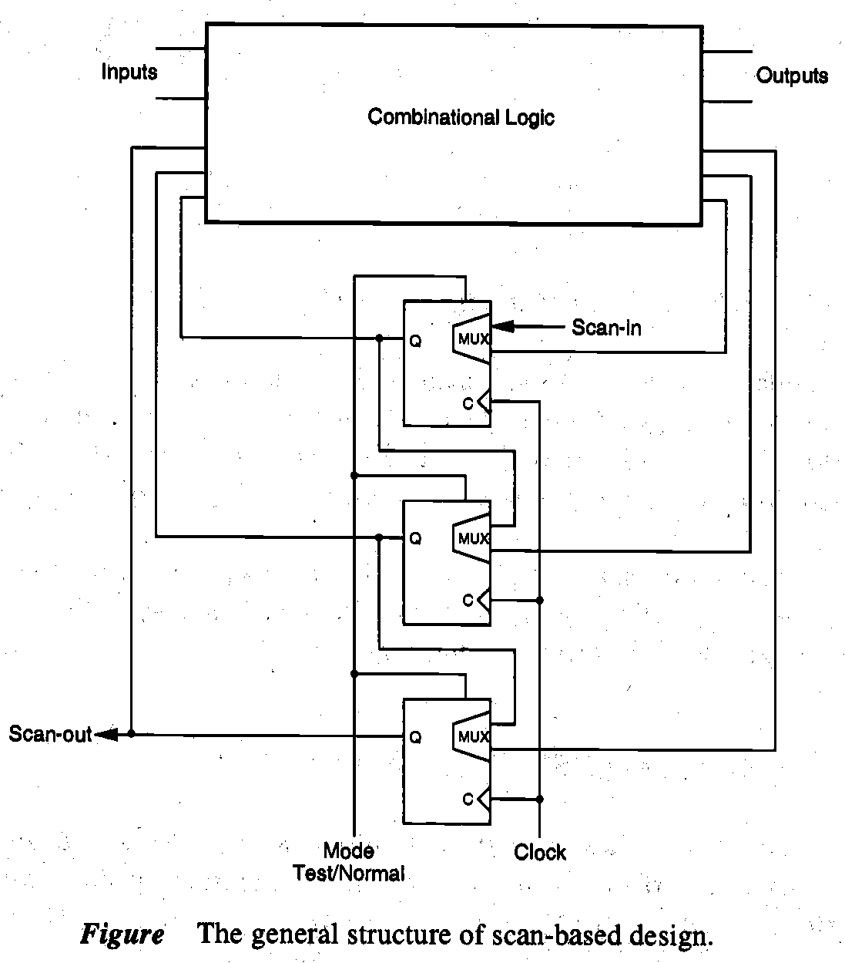
Continue…
The testing sequence is as follows:
Step 1: Set the mode to test and, let latches accept data from scan-in input,
Step 2: Verify the scan path by shifting in and out the test data.
Step 3: Scan in (shift in) the desired state vector into the shift register.
Step 4: Apply the test pattern to the primary input pins. I : ;
Step 5: Set the mode to normal and observe the primary outputs of the circuit after sufficient time for propagation.,
Step 6: Assert the circuit clock, for one machine cycle to capture the outputs of the combinational logic into the registers.
Step 7: Return to test mode; scan out the contents of the registers, and at the same time scan in the next pattern.
Step 8: Repeat steps 3-7 until all test patterns are applied.

Slide 16
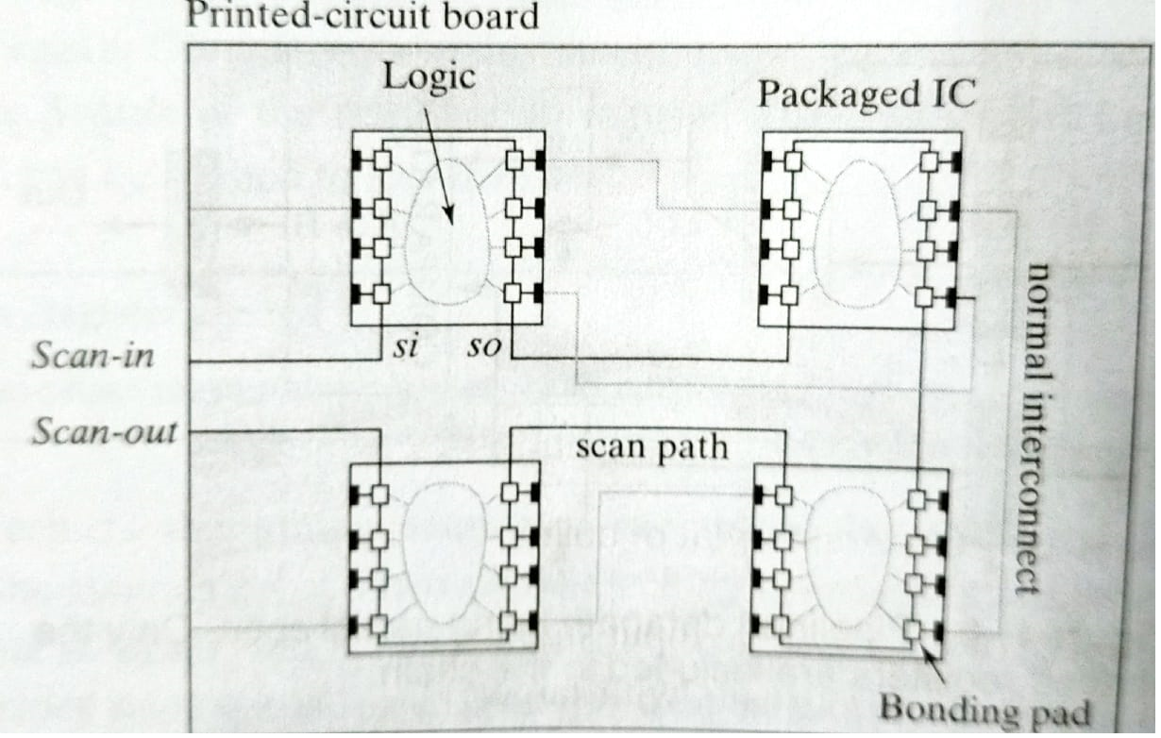
Boundary Scan design
Testing circuit board was facilitated by the abundant availability of test points.
The through hole mounting approach made every pin of a package observable at the back side of the board .
For test it was sufficient to lower the board onto a set of test probes and apply and observe the signals of interest.
Controllability and observability are not as readily available anymore because the number of probe points is dramatically reduced. This problem can be addressed by extending the Scan –based approach to the component and board levels.

Slide 17
Continue….
The resulting approach is called boundary scan and has been standardized to ensure compatibility between vendors.
In essence it connects the input-output pins of the components on a board into a serial scan chain.
During normal operation the boundary scan pads act as normal input output devices.
In test mode vectors can be scanned in and out of the pads providing controllability and observability at the boundary of components.

Slide 18
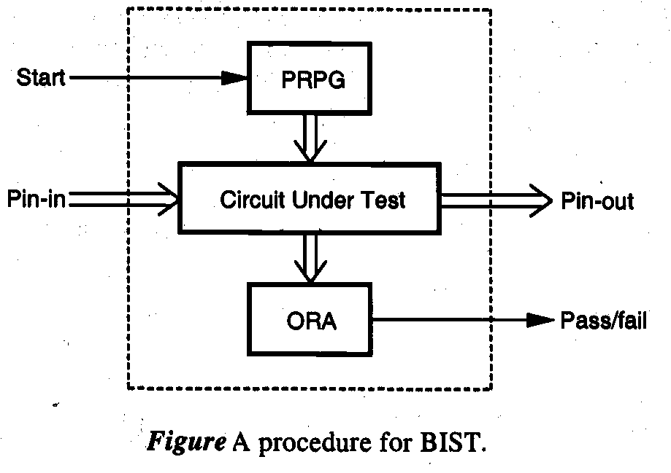
Built-In Self Test (BIST) Techniques
In built-in self test (BIST) d sign, parts of the circuit are used to test the circuit itself.
Online BIST is used to perform the test under normal operation, whereas off-line BIST isused to perform the test off-line.
The essential circuit modules required for BIST include:
* Pseudo random pattern generator (PRPG)
* Output response analyzer (ORA)
The roles of these two modules are illustrated in Fig

Slide 19
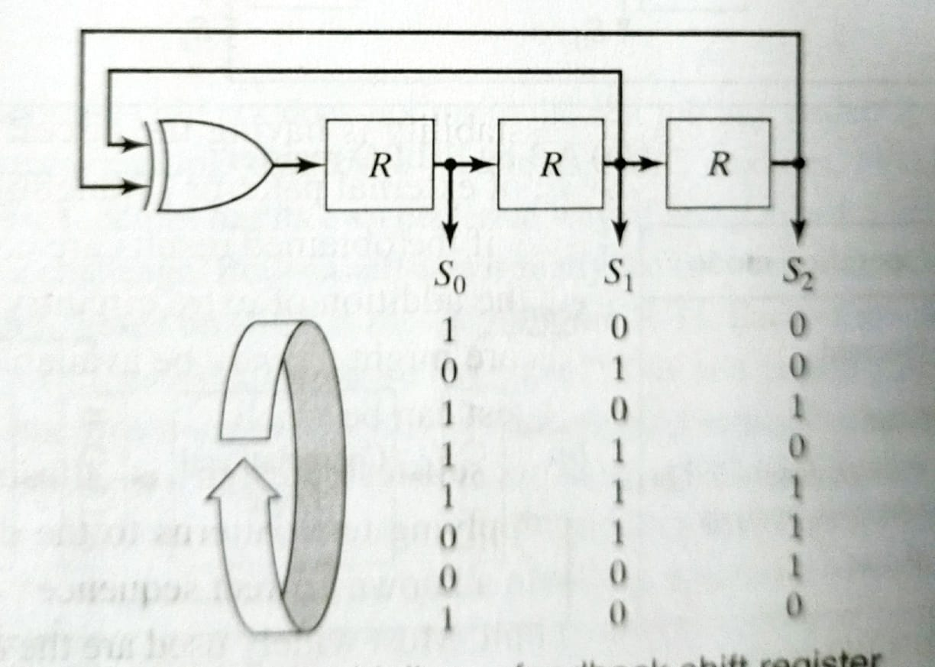
LFSR(Linear Feedback Shift Register)

Slide 20
Thank You

